Slide 1
Weather Forecaster
Mujeeb Adelekan

Slide 2
Problem (1 of 2)
Importance of climate on human life
Changes lead to disruptions of facilities
In 2021:
Texas Power Crisis
Pacific Northwest Heat Dome
Hurricane Ida
December Ohio Valley Tornado Valley

Slide 3
Problem (2)
Non-coastal communities overlooked
Local forecasts usually span a week or two
Most extensive forecasts span about 6 months
The farther the date, the less accurate the forecast
Question: Can a weather forecaster be trained to predict the weather for each date in a full calendar year?

Slide 4
Research (1 of 2)
S. Borenstein: Global warming is worsening, and the global ecosystem is threatened, per United Nations report.
2015 Paris Climate Agreement threshold (1.5 degrees Celsius above 19th century levels) will be passed.
Effects directly proportional to the amount of heat-trapping gases
Y. Zhang and A.L. Steiner: Warmer temperatures and increased CO2 emissions will create a more intense pollen allergy season.

Slide 5
Research (2 of 2)
J. Anochi et al.: Machine learning used for climate precipitation modeling in Brazil
The forecasting ability of a supervised neural network for seasonal precipitation in South America is compared to the general atmospheric model used by the National Institute for Space Research
C.M. Soares et. al.: Forecasting meteorological convective events (MCEs) in Brazil for aviation purposes
C. Kirkwood et al.: A regression forest algorithm used to aggregate the results of numerical weather prediction models to provide probabilities of weather outcomes

Slide 6
Project
Weather data for Greater San Antonio is obtained from the National Weather Service.
Spans March 1, 2017, to February 28, 2022 (1826 days)
Forecasting Model-Based Machine Learning Algorithm: Random Forest Regression using skforecast
Trained on the first four of the five years (March 1, 2017 – February 28, 2021)
Tested on how will it predicts 2021-2022 year (March 1, 2021 – February 28, 2022)
Model will then perform predictive analysis based on the past five years
Predicted the weather from March 1, 2022 to February 28, 2023

Slide 7
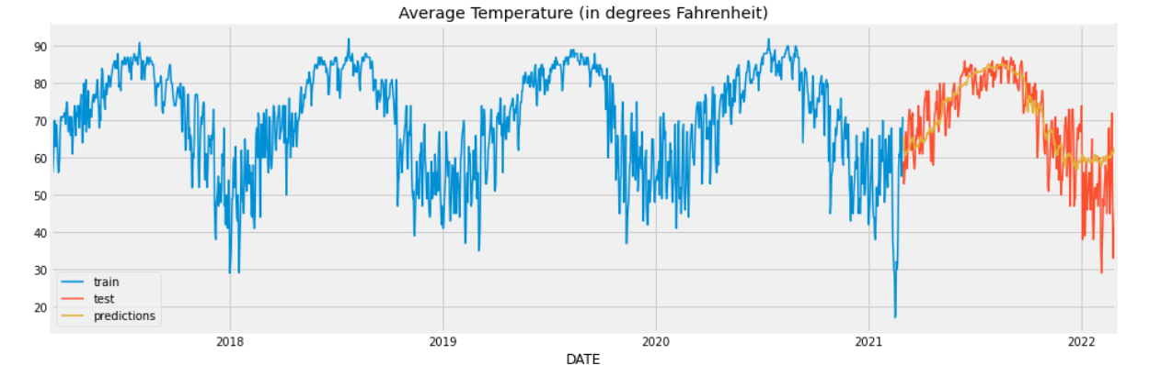
Testing Model on 2021-2022 year

Slide 8
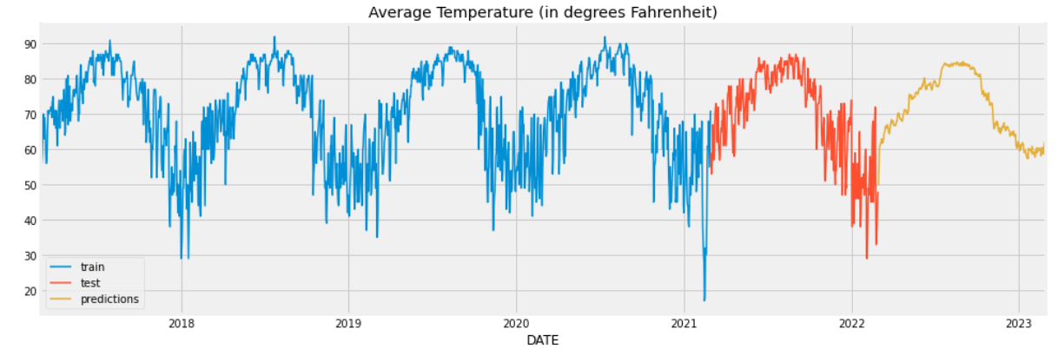
Predicting 2022 -2023 Year

Slide 9
Potential Impact and Extensions
Framework for generating long-term climate information
Help local communities like San Antonio:
Prepare for weather events
Seriously consider the challenges posed by climate change
Weather services may build on predictive analysis process
Can flag concerning climate patterns
Can encourage policymakers to reduce human-driven climate change

Slide 10
Reference (1 of 2)
Y. Zhang and A. L. Steiner, “Projected climate-driven changes in pollen emission season length and magnitude over the continental United States,” in Nature Communications, Mar. 2022. [Online]. Available: https://doi.org/10.1038/s41467-022-28764-0
S. Borenstein, “‘Code red’: UN scientists warn of worsening global warming.” APNews.com. https://apnews.com/article/asia-pacific-latin-america-middle-east-africa-europe-1d89d5183583718ad4ad311fa2ee7d83 (accessed March 18, 2022).
S. Borenstein, “UN climate report: ‘Atlas of human suffering’ worse, bigger.” APNews.com. https://apnews.com/article/climate-science-europe-united-nations-weather-8d5e277660f7125ffdab7a833d9856a3 (accessed March 18, 2022).
J. A. Anochi, V. A. de Almeida, and H. F. de Campos Velho, “Machine Learning for Climate Precipitation Prediction Modeling over South America,” Remote Sensing, vol. 13, no. 13, p. 2468, Jun. 2021, doi: 10.3390/rs13132468.
C. Kirkwood, T. Economou, H. Odbert, and N. Pugeault, “A framework for probabilistic weather forecast post-processing across models and lead times using machine learning,” Phil. Trans. R. Soc. A., vol. 379, no. 2194, Feb. 2022, doi: 10.1098/rsta.2020.0099.

Slide 11
References (2 of 2)
C.M. Soares, G.B. França, M.V. de Almeida, and V.A. de Almeida, “Study of GOES-R Thermodynamic Indices for Short-Term Forecasting of Convective Weather Events Using Machine Learning,” Pure and Applied Geophysics, Nov. 2021, doi: 10.1007/s00024-021-02889-7.

